Slide 1
Introduction to Software Engineering
Introduction (2)
Muhammad Nasir
m.nasir@iiu.edu.pk

Slide 2
Chapter - Topic Covered
Layered Technology
Software Process Framework
Generic Process Framework Activities
Umbrella Activities

Slide 3
Software Engineering – Layered Technology
Layered Technology
Tools: CASE preferred
Methods: Technical “How to’s”
Process model: the “framework”
A quality focus: the “bedrock”

Slide 4
Layered Technology
A Quality Focus
Every organization rest on its commitment to quality.
Total quality management, CMM, or similar continuous improvement culture
Culture ultimately leads to development of increasingly more effective approaches to software engineering.
The bedrock that supports software engineering is a quality focus.
Notes:
CMM: Capability Maturity Model
Initial (chaotic, ad hoc, individual heroics) - the starting point for use of a new or undocumented repeat process.
Repeatable - the process is at least documented sufficiently such that repeating the same steps may be attempted.
Defined - the process is defined/confirmed as a standard business process.
Managed - the process is quantitatively managed in accordance with agreed-upon metrics.
Optimizing - process management includes deliberate process optimization/improvement.

Slide 5
Layered Technology
Process
It provide the technical how-to's for building software.
Process encompass a broad array of activities that include requirements analysis, design, program construction, testing, and support.
There could be more than one technique to perform a task and different techniques could be used in different situations.
Tools:
Provide automated or semi-automated support for the process, methods and quality control.
When tools are integrated so that information created by one tool can be used by another, a system for the support of software development, called computer-aided software engineering (CASE)

Slide 6
A Process Framework
A Process Framework/Model can be Linear Sequential Model, Spiral Model
A Framework has Process Activities i.e. Software Analysis, Software Design, Software Implementation, Software Testing, Software Deployment
Each activity has collection of Action/Tasks. For example Software Analysis has Actions/ Tasks i.e. Requirement Elicitation, Requirement Prioritization, Requirement Specification etc
To achieve a Task we have Methods i.e. For Requirement Elicitation we tasks like Interviews, Observation etc

Slide 7
Process Framework
Process Framework
Umbrella Activities
  Framework activities
  work tasks
    work products
    milestones & deliverables
    QA checkpoints

Slide 8
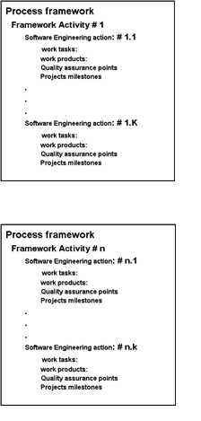
Process Framework
Each framework activity is populated by a set for software engineering actions or collection of related tasks.

Slide 9
Generic Process Framework Activities
Communication:
  Heavy communication with customers, stakeholders, team
  Encompasses requirements gathering and related activities
Planning:
  Describe technical task, likely risk, resources will require, work products to be produced and a work schedule.
Modeling:
  Help developer and customer to understand requirements (Analysis of requirements) & Design of software
Construction:
  Code generation: either manual or automated or both
  Testing – to uncover error in the code.
Deployment:
  Delivery to the customer for evaluation
  Customer provide feedback

Slide 10
The Process Model: Adaptability
The framework activities will always be applied on every project ... BUT
The tasks for each activity will vary based on:
  The type of project
  Characteristics of the project

Slide 11
Umbrella Activities
Software Project Tracking and Control
  Assessing progress against the project plan.
  Take adequate action to maintain schedule.
Formal Technical Reviews
  Assessing software work products in an effort to uncover and remove errors before goes into next action or activity.
Software Quality Assurance
  Define and conducts the activities required to ensure software quality.
Software Configuration Management
  Manages the effects of change.

Slide 12
Umbrella Activities
Document Preparation and Production
  Help to create work products such as models, documents, logs, form and list.
Reusability Management
  Define criteria for work product reuse
  Mechanisms to achieve reusable components.
Measurement
  Define and collects process, project, and product measures
  Assist the team in delivering software that meets customer’s needs.
Risk management
  Assesses risks that may effect the outcome of project or quality of product (i.e. software)

Slide 13
What are software myths?
Beliefs about software and the process used to build it. Myths have number of attributes that have made them dangerous.
Misleading Attitudes - caused serious problem for managers and technical people.

Slide 14
Management Myths
Managers in most disciplines, are often under pressure to maintain budgets, keep schedules on time, and improve quality.
Myth1: We already have a book that's full of standards and procedures for building software, won't that provide my people with everything they need to know?

Slide 15
Management Myths
Reality :
Are software practitioners aware of existence standards?
Does it reflect modern software engineering practice?
Is it complete? Is it streamlined to improve time to delivery while still maintaining a focus on quality?

Slide 16
Management Myths
Myth2: If we get behind schedule, we can add more programmers and catch up
Reality: Software development is not a mechanical process like manufacturing. Adding people to a late software project makes it later.
People can be added but only in a planned and well-coordinated manner

Slide 17
Management Myths
Myth3: If I decide to outsource the software project to a third party, I can just relax and let that firm build it.
Reality: If an organization does not understand how to manage and control software projects internally, it would require more struggle when it outsource software projects

Slide 18
What is a Customer?
Customer may be a person from inside or outside the company that has requested software under contract.

Slide 19
Customer Myths
Myth: A general statement of objectives is sufficient to begin writing programs— we can fill in the details later.
Reality: A poor up-front definition is the major cause of failed software efforts.
A formal and detailed description of the information domain, function, behavior, performance, interfaces, design constraints, and validation criteria is essential.
These characteristics can be determined only after thorough communication between customer and developer.

Slide 20
Customer Myths
Myth: Project requirements continually change, but change can be easily accommodated because software is flexible.
Reality: Customer can review requirements and recommend modifications with relatively little impact on cost.
When changes are requested during software design, the cost impact grows rapidly. Below mentioned figure for reference.

Slide 21
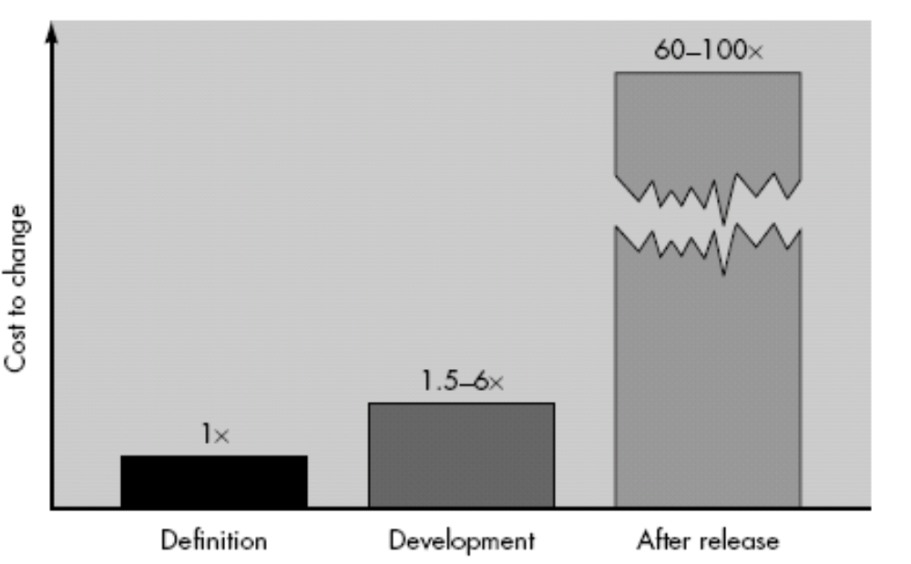
Cost of Change in Software Development Life Cycle

Slide 22
Practitioners Myths
Myth1: Once we write the program and get it to work, our job is done.
Reality: Someone once said that "the sooner you begin 'writing code', the longer it'll take you to get done." Industry data indicate that between 60 and 80 percent of all effort expended on software will be expended after it is delivered to the customer for the first time.

Slide 23
Practitioners Myths
Myth2: Until I get the program "running" I have no way of assessing its quality.
Reality: One of the most effective software quality assurance mechanisms can be applied from the inception of a project—the formal technical review.

Slide 24
Practitioners Myths
Myth3: The only deliverable work product for a successful project is the working program.
Reality: A working program is only one part of a software configuration that includes many elements. Documentation provides a foundation for successful engineering and, more important, guidance for software support.

Slide 25
Practitioners Myths
Myth4: Software engineering will make us create verbose unnecessary documentation and will definitely slow us down.
Reality: Software engineering is not about creating documents. It is about creating quality. Better quality leads to reduced rework. And reduced rework results in faster delivery times.

Slide 26
The End
Thanks for Listening

